Slide 1

SEMI AUTOMATIC SOLAR PANNEL CLEANING SYSTEM
Name of the student
Supervisor
Prof. Bijay Kumar Singh
(Assistant Professor)
Department of Electrical Engineering
GEC Khagaria, Bihar -848203
Rakhi Kumari (22103154929)
Bharti kumari (22103154930)
Nikita kumari (22103154931)
Prabhash kumar (22103154932)
Chandani kumari (22103154934)
Gyanendra kumar (22103154936)
31th May 2025

Slide 2
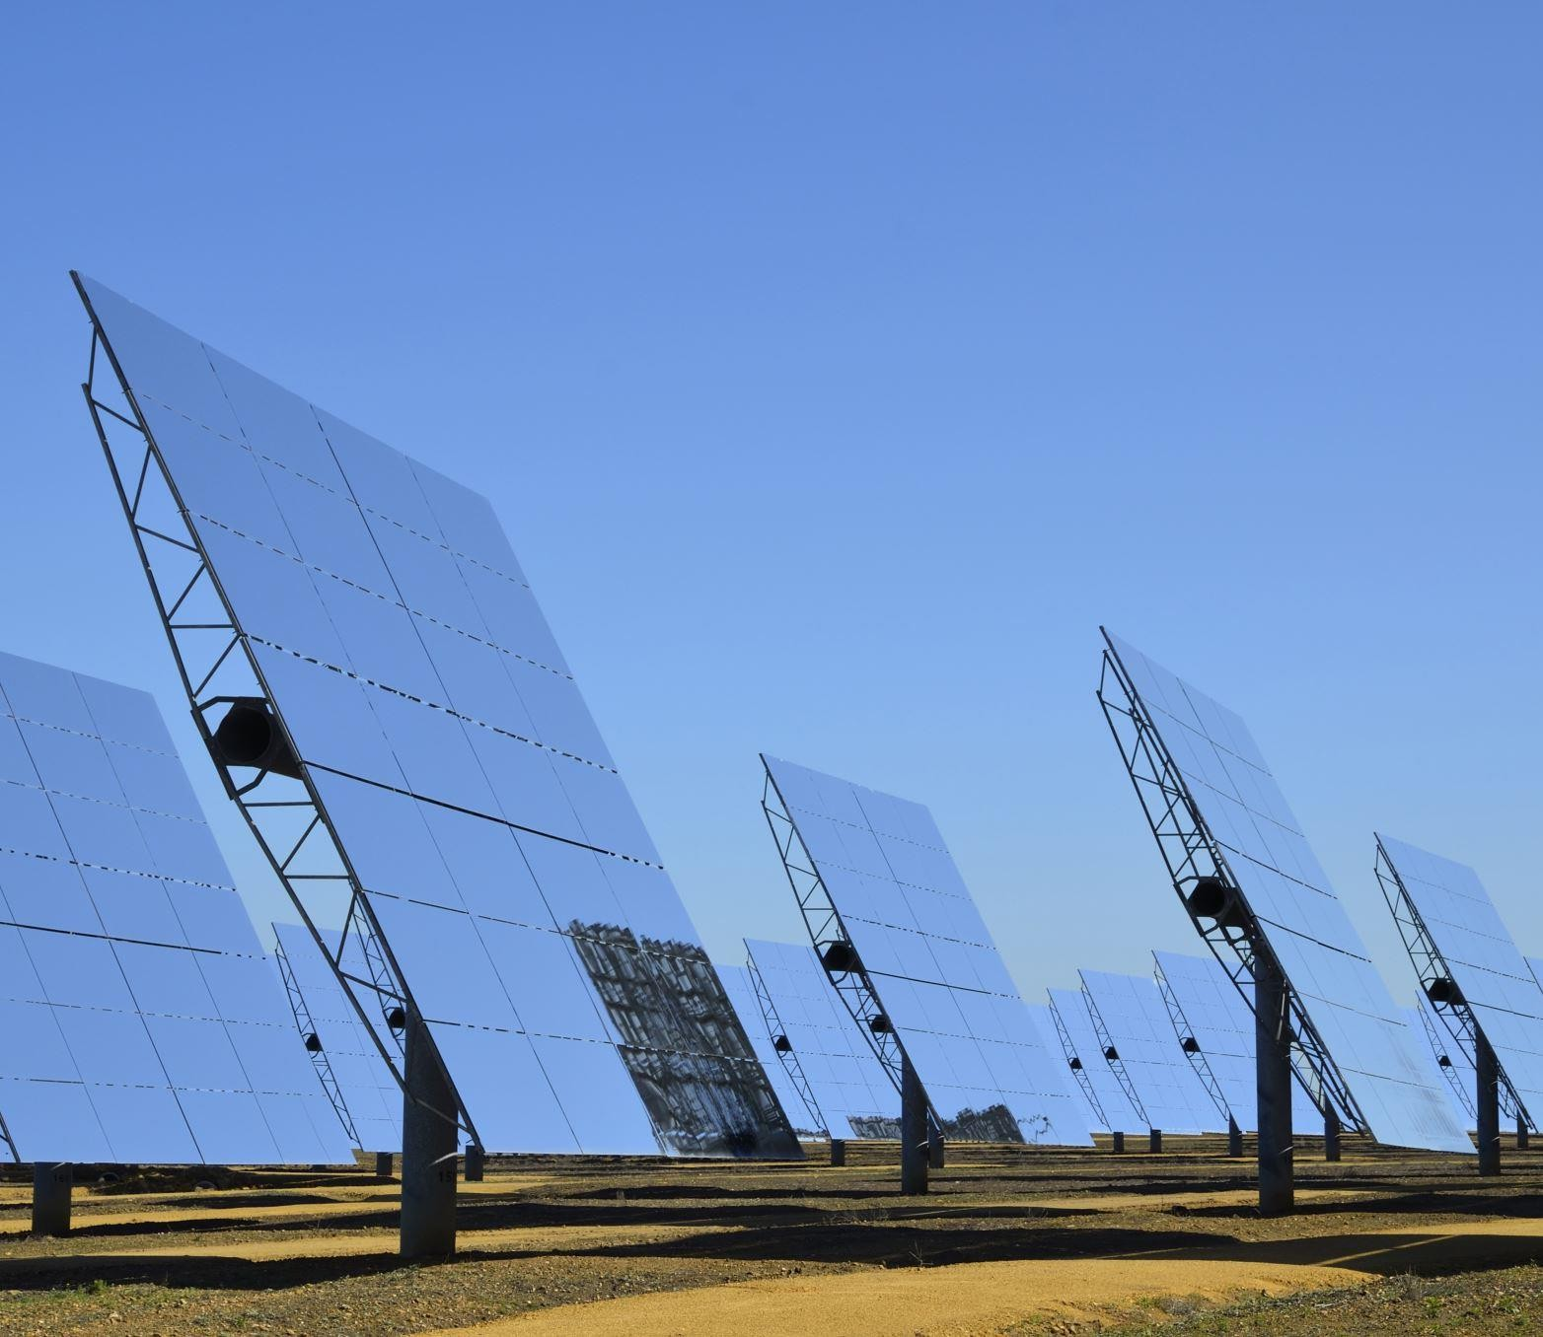
Automatic
Solar Panel Cleaning System Project

Slide 3
Content
Introduction
Objective
Hardware component
Working principle
Block Diagram
Application
Advantage
Conclusion

Slide 4
Timeline of the Project
week-1
(project initiation and planning)
Week-2
(arrange all the equipments)
Week-3
(assemble all the equipments)
Week-4
(documentation and report writing)
Week-5
(final testing and validation)
Week-6
(presentation and project conclusion)

Slide 5
Introduction
Importance of solar energy
Impact of dust/dirt on solar panel efficiency
Need for an automatic cleaning system

Slide 6
Objective
To design and implement a system that automatically cleans solar panels
Reduce manual effort and also increase the panel efficiency

Slide 7
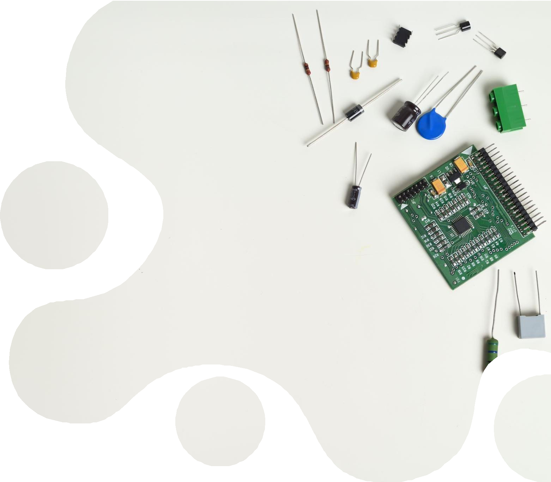
:Hardware Components
Ardunio UNO
Solar Panel
10 RPM Gear Motor
Wiper Blade
Water Pump
Pipe
Wire Lead
Diodes
Electrolytic Capacitor
Transformer
5v Voltage Regulator

Slide 8
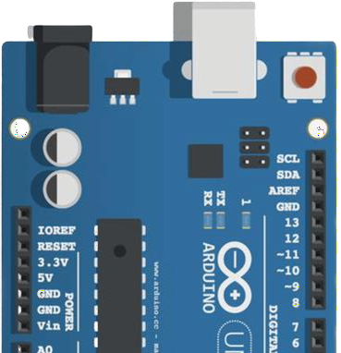
Arduino UNO
Arduino is an open-source platform based on easy-to-use hardware and software. Arduino Boards are able to read inputs from either sensors, buttons or some software request and turn that input request to some output by either

Slide 9
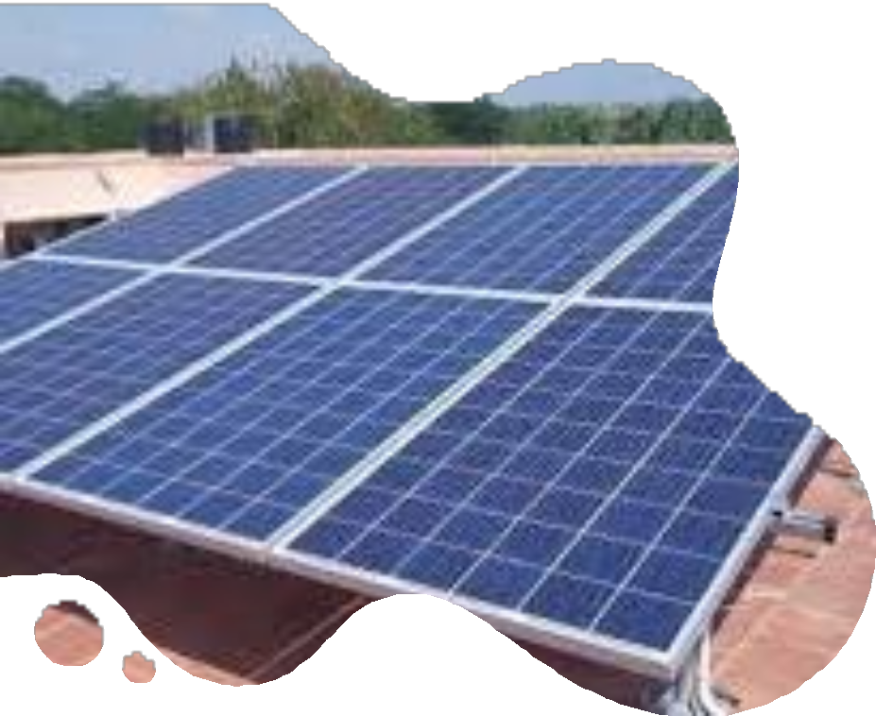
Solar Panel
The solar panel is the core component of the system, responsible for converting sunlight into electrical energy through the photovoltaic (PV) effect.

Slide 10
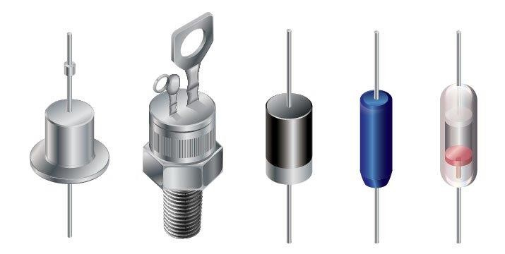
Diodes
A diode is a semiconductor device that essentially acts as a one-way switch for current.
It allows current to flow easily in one direction, but severely restricts current from flowing in the opposite direction.

Slide 11

ELECTROLYTIC CAPACITOR
The capacitor is a component which has the ability or “capacity” to store energy in the form of an electrical charge producing a potential difference (Static Voltage) across its plates, much like a small rechargeable battery.

Slide 12
Working principle
Sensor detects dust or cleansing interval
Controller activates motor
Brushes moves across the panel surface
Cleansing cycle completes,system returns to standby

Slide 13
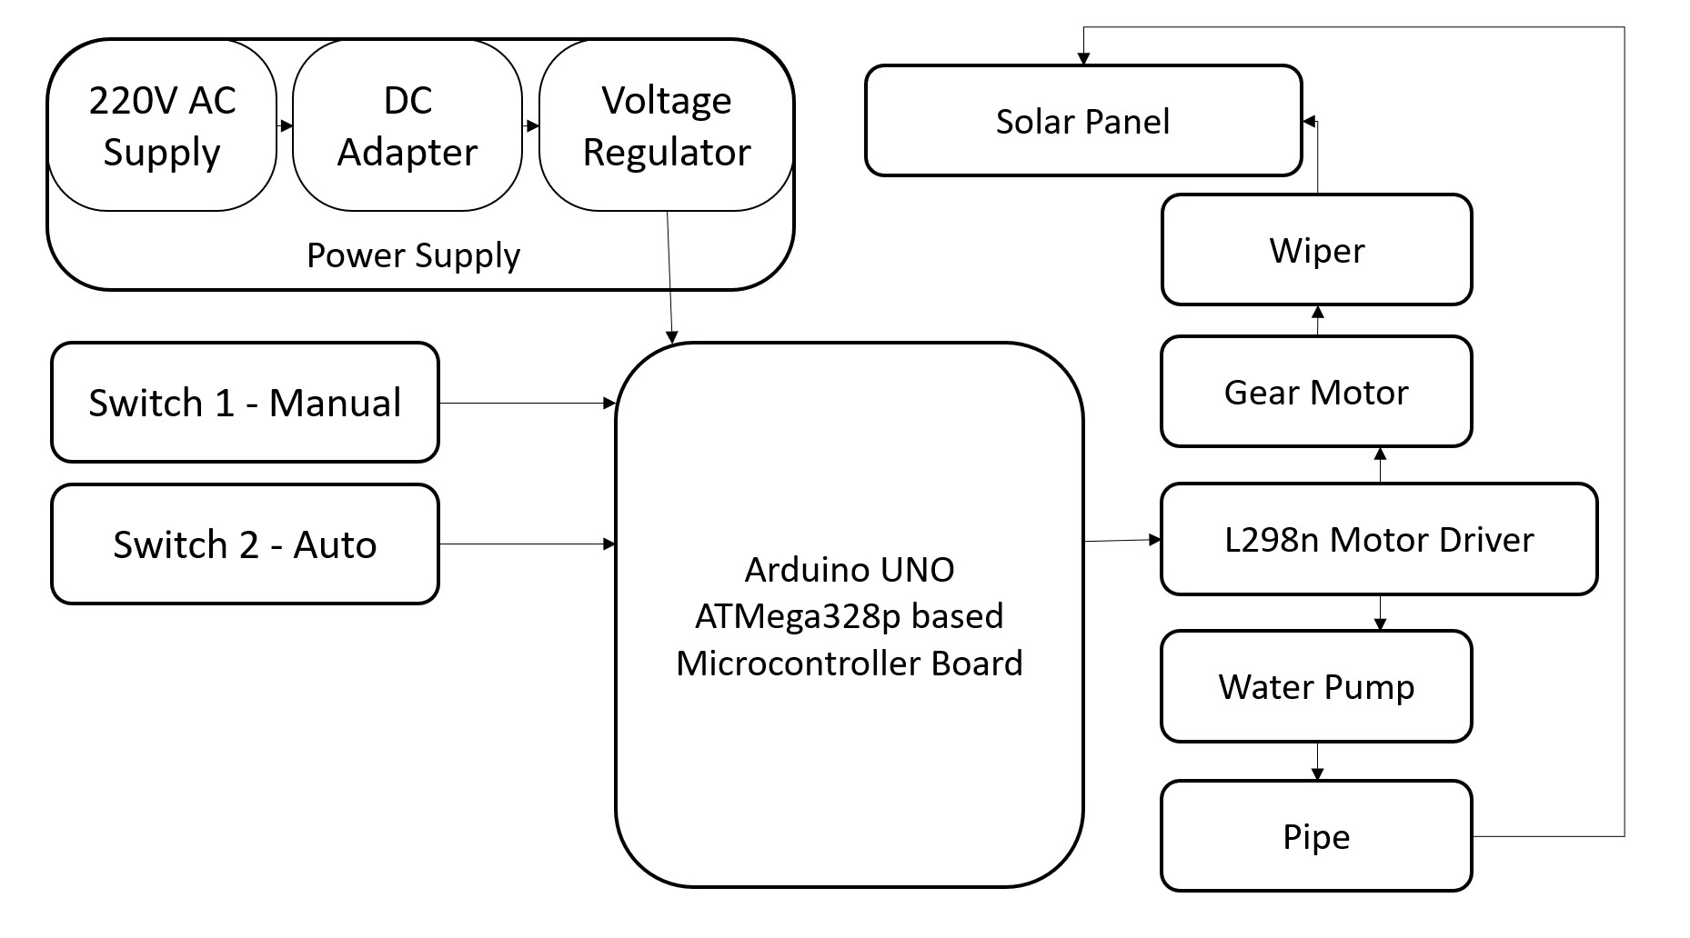
Block Diagram

Slide 14
Application
Residential rooftop panels
Solar farms
Remote area installations
Commercial buildings

Slide 15
Advantages
Maintains efficiency
Reduces manual efforts
low maintenance
Cost effective over time

Slide 16
Conclusion
An effective solution to maintain solar panel efficiency
Automation helps reduce human intervention
Future advancements will further enhance their utility and effectiveness

Slide 17

Thank you

